Slide 1
Genomic copy number variation and domestication in goats
Abby Vander Linden
FoodSci 797A Spring 2020 Project

Slide 2
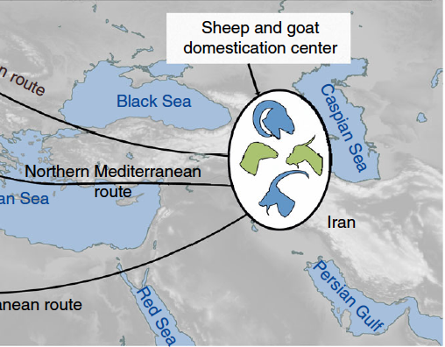
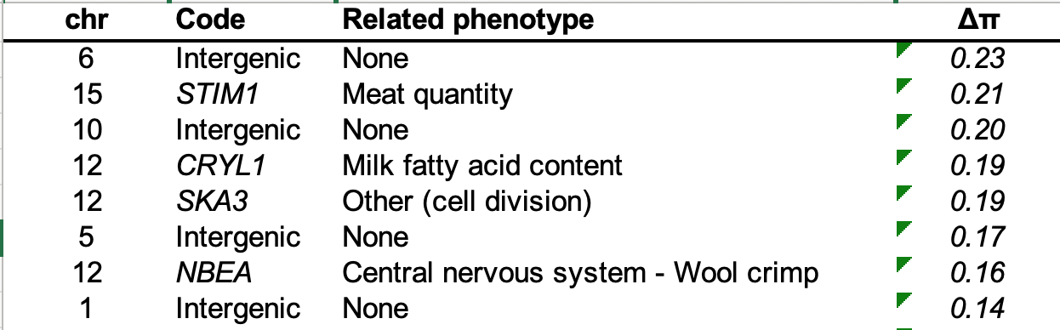
Signatures of selection in domestic goats: directional selection for genes linked to meat/dairy production, coat color, body size, and regulatory regions
Alberto et al. 2018

Slide 3
Copy number variation (CNV) downstream of the KIT locus linked to coat color/hair texture phenotypic differences in domestic and wild goats
Steenwyck and Rokas 2018
Henkel et al. 2019

Slide 4
Methods:
sratoolkit
BWA mem
Samtools
Goal 1 (this study so far): identify copy number variations between domestic and wild goat genomes
Goal 2 (future work): investigate relationship between CNV and selection during domestication in goats
Download Illumina paired-endwhole-genome sequencing reads for 1 domestic Iranian goat (Capra hircus) and 1 wild bezoar ibex (Capra aegagrus) from SRA; sequenced by Alberto et al. 2018.
Trim_galore
Map reads against goat reference genome (GenBank); sort BAM file
Quality and adapter trim reads.
Separate chromosomes into individual sequence files
Visualize CN across chromosomes in domestic and wild sequences
Estimate CNV
Control-FREEC
R
ggplot2
Samtools

Slide 5
Results: 1,792 CNVs in domestic goats and 1,814 CNVs in wild goats relative to goat reference genome

Slide 6
Results: CNVs present across all chromosomes

Slide 7
Some regions previously identified as under selection:

Slide 8
Future work:
Increase sampling of domestic and wild whole genome sequences
Identify specific genes that are completely overlapped by CN regions
Quantify the extent of copy number divergence between domestic and wild goats and look for possible signatures of selection during domestication

